Slide 1

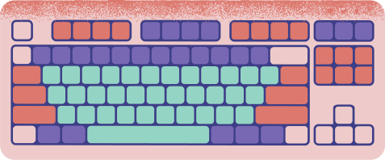



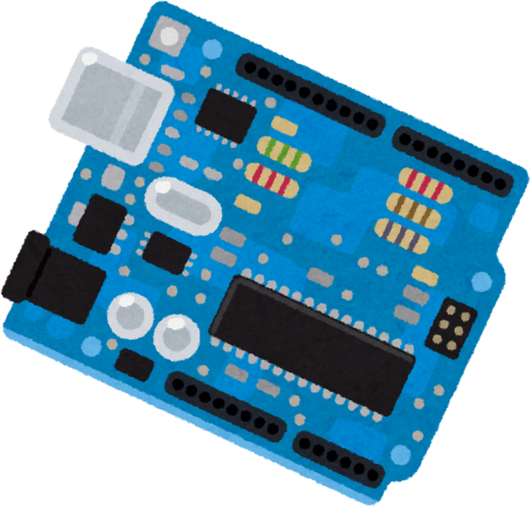






ARDUINO ENHANCED
VISION SUPPORT CANE
S UDHAYA SANKARI
(BL.EN.U4CSE23150)
GEETHIKA YARABOLU
(BL.EN.U4CSE23123)
KADALI NIKSHITA
(BL.EN.U4CSE23128)
PRESENTED TO: Ms. NIDHI SONI

Slide 2




INDEX
ABSTRACT
INTRODUCTION
HARDWARE REQUIREMENTS
SOFTWARE REQUIREMENTS
BUDGET OF THE PROJECT
SYSTEM FLOW DIAGRAM
MODULES
IMPLEMENTATION
CONCLUSION

Slide 3



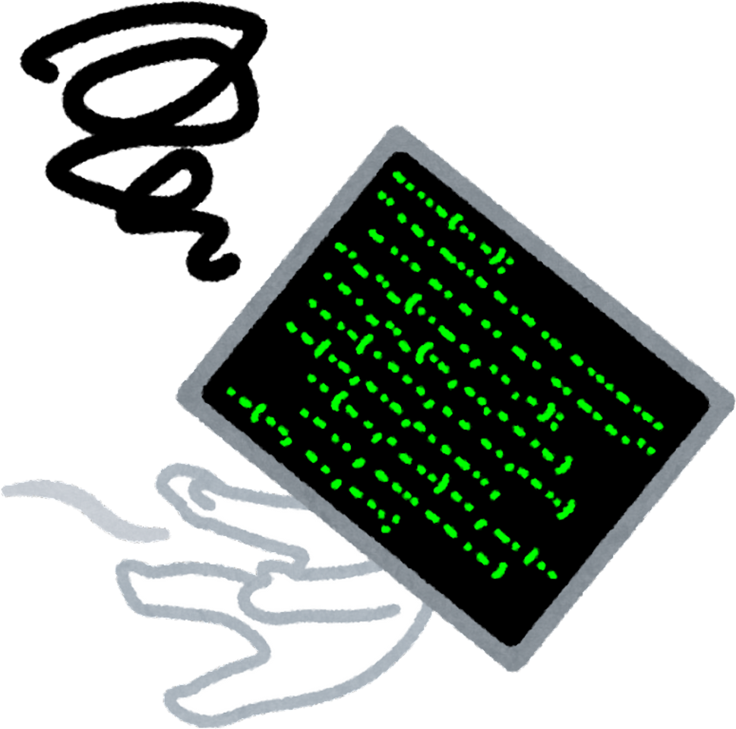

ABSTRACT

Slide 4
This project involves the development of a smart walking stick designed for visually impaired individuals. The stick is equipped with an Ultrasonic Sensor to detect obstacles which provides feedback through sound alerts from a Buzzer and a Soil Moisture Sensor which detects the prescence of water and provides feedback through a speaker. Furthermore it is equiped with a Panic button integrated with SOS in the event of an emergency. The project aims to enhance the mobility and safety of visually impaired users through embedded system technology.

Slide 5



INTRODUCTION

Slide 6
The proposed system is designed to assist visually impaired individuals by providing them with a smart walking stick that uses advanced technologies. The system incorporates ultrasonic sensors to detect obstacles which has an embedded speaker and a soil moisture sensor to detect water .In addition to this there is a panic button integrated with SOS in case of an emergency.

Slide 7



HARDWARE REQUIREMENTS

Slide 8
Arduino Uno: Microcontroller board for processing sensor data and controlling output devices.
Ultrasonic Sensor (e.g., HC-SR04): Detects obstacles by measuring the distance using ultrasonic waves.
Buzzer: Provides tactile or auditory feedback to the user.
Moisture Sensor: Detects the presence of water to alert the user.
Panic button ( SOS switch)
Mini speaker
9V Battery : Powers the system.
Jumper Wires and Breadboard: For circuit connections and prototyping.
Stick or Cane: To mount the components

Slide 9



SOFTWARE REQUIREMENTS

Slide 10
Arduino IDE: Integrated Development Environment for writing, compiling, and uploading the C program to the Arduino Uno.
Embedded-C: Programming language used for developing the software that controls the system.

Slide 11



BUDGET OF PROJECT

Slide 12

Arduino Uno- Rs. 2636
Ultrasonic sensor (e.g., HC-SR04)- Rs.169
Soil moisture sensor- Rs.120
Buzzer and 9V battery- Rs.90
Panic button ( SOS switch) - Rs.299
Mini speaker - Rs.90
Jumper wires- Rs.100
Usb cable- Rs.200
Breadboard- Rs.150
Stick or cane (to mount the components)- Rs.200-Rs.300

Slide 13



SYSTEM FLOW DIAGRAM

Slide 14

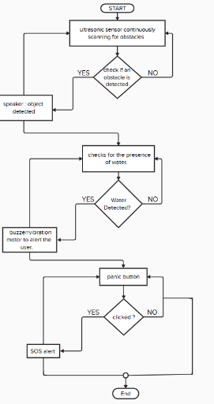

https://app.mural.co/t/cproj6065/m/cproj6065/1723889043702/5173d383640f3dec95f6c346b08fc4425c514ee0?sender=ud9781be094c2f87c13807094

Slide 15




MODULES

Slide 16
Obstacle Detection Module
Uses the ultrasonic sensor to detect obstacles and triggers alerts.
Water Detection Module:
Employs the moisture sensor to detect water and alerts the user.
SOS Module:
panic switch in case of emergencies.
Speaker Module:
Transmits audio alerts when obstacles or slippery surfaces are detected.
Power Management Module:
Manages power supply to the system components.

Slide 17



iMPLEMENTATION

Slide 18
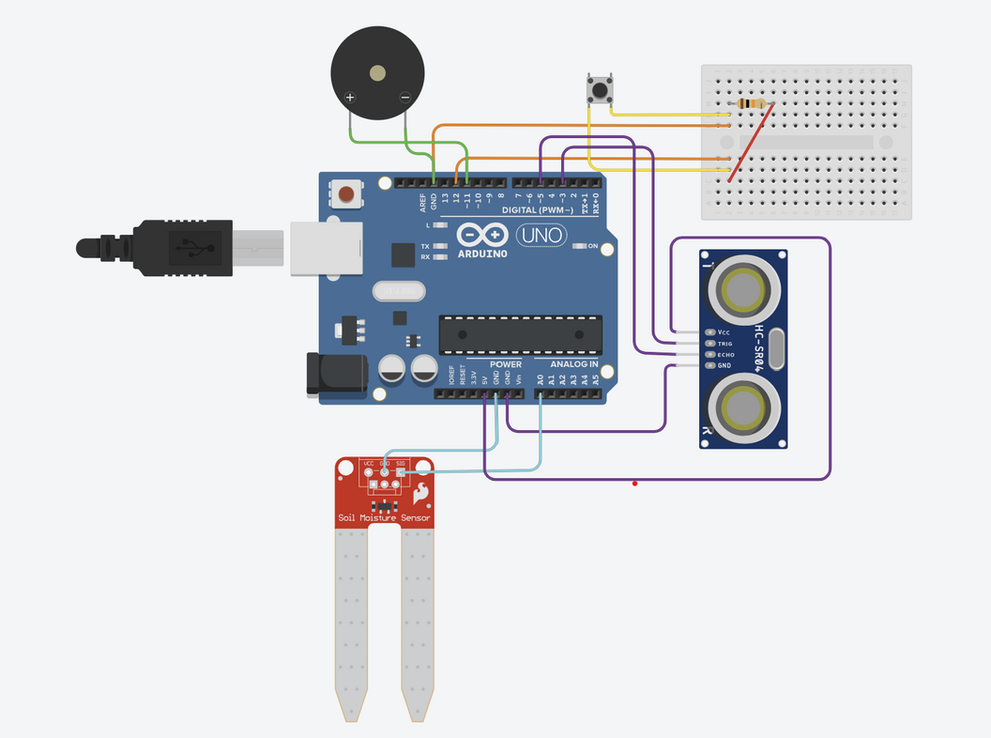
https://www.tinkercad.com/things/aj2Bhaut9Lh-c-simulation-1

Slide 19
CONCLUSION
The project -Walking Stick for visually impaired people successfully implements a portable and affordable solution for visually impaired individuals. By integrating multiple sensors and a microcontroller, the system provides real-time feedback to the user, enhancing their ability to navigate safely. The project demonstrates the effective use of embedded systems in addressing real-world challenges and improving the quality of life for visually impaired individuals.

